Slide 1
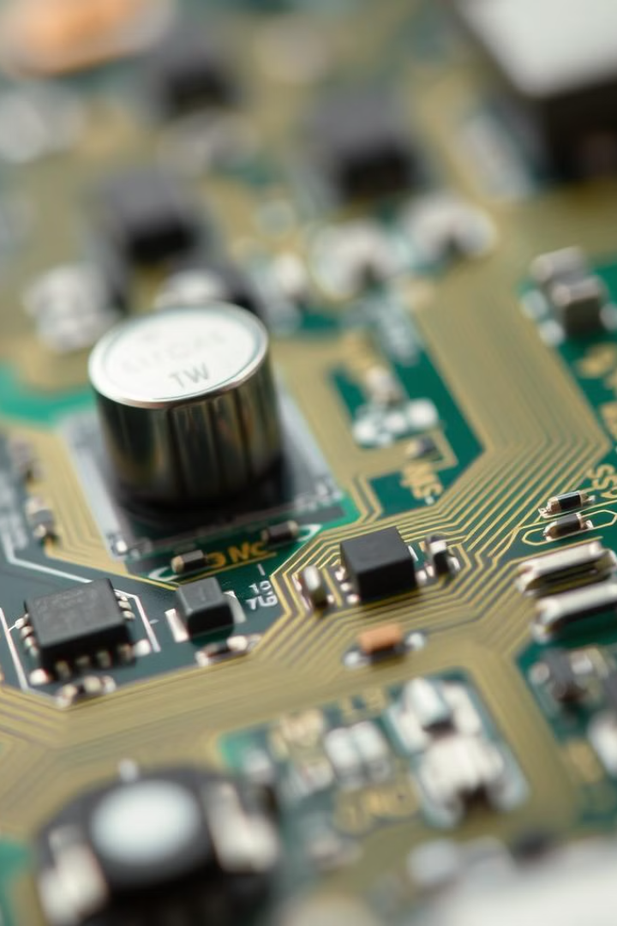

Renesas Acquires Altium for $5.9B
Renesas expands into digital design tools.
by Saquib Alhoque

Slide 2
Deal Overview
Acquirer
Renesas Electronics Corporation
Acquiree
Altium Limited
Deal Size
$5.9 billion
Price Per Share
$68.5

Slide 3
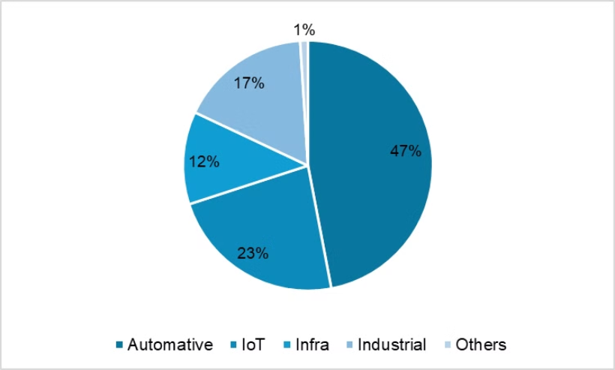
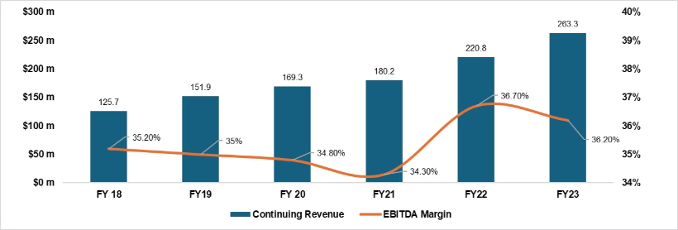
Company Overviews
Renesas
Altium
Global semiconductor solutions provider.
Leading EDA software company.

Slide 4
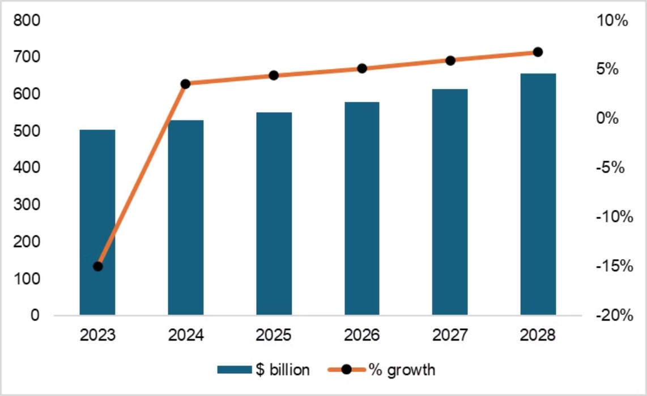
Industry Analysis
1
Challenges
2
Growth
3
Trends
Supply chain, recession fears.
5.3% CAGR projected 2023-2028.
AI, IoT, 5G drive demand.

Slide 5
Deal Rationale
Revenue Synergy
Cost Synergy
Risks
Broader reach, cross-selling.
Streamlined operations, scale.
Integration, software expertise.

Slide 6
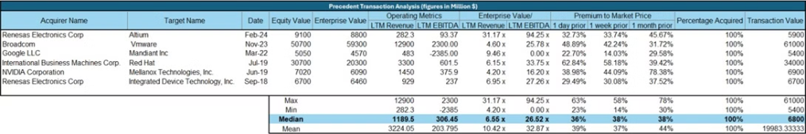
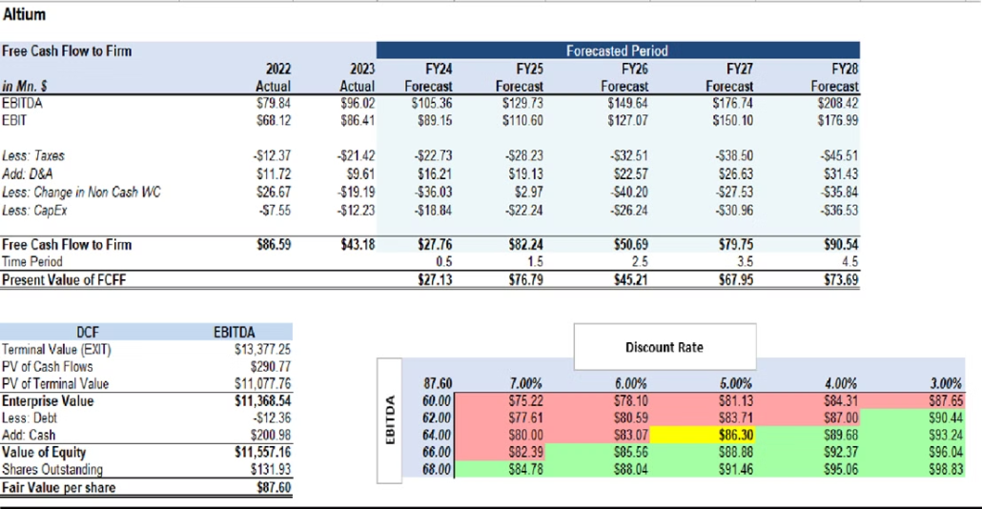
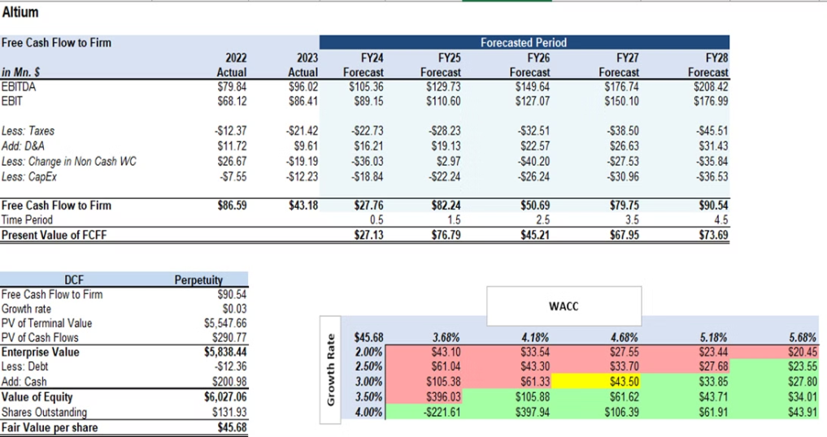
Deal Valuation
Precedent Transactions
Compared to similar deals.
DCF Analysis
Projected future cash flows.

Slide 7
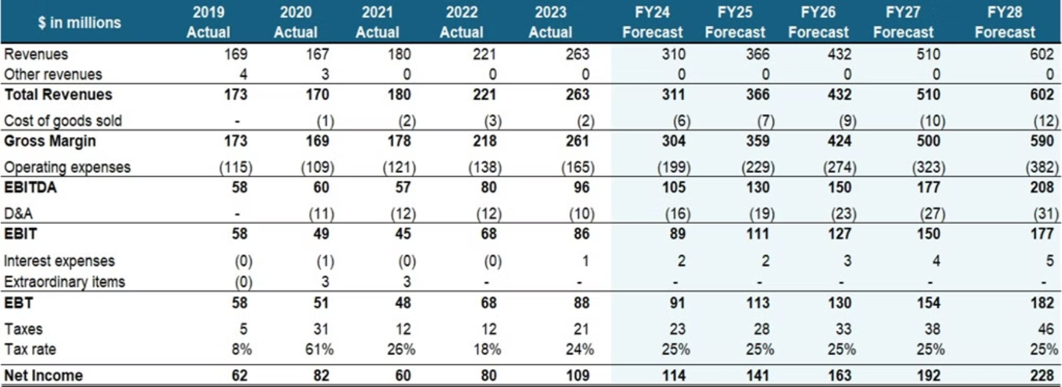
Valuation Models
Income Statement
Projected financials.

Slide 8

Conclusion
1
Strategic Acquisition
2
Market Presence
Expands Renesas' capabilities.
Strengthens position in design.
3
Outbound M&A
Aligns with Japan's trend.
Renesas WSJ Article

